Slide 1

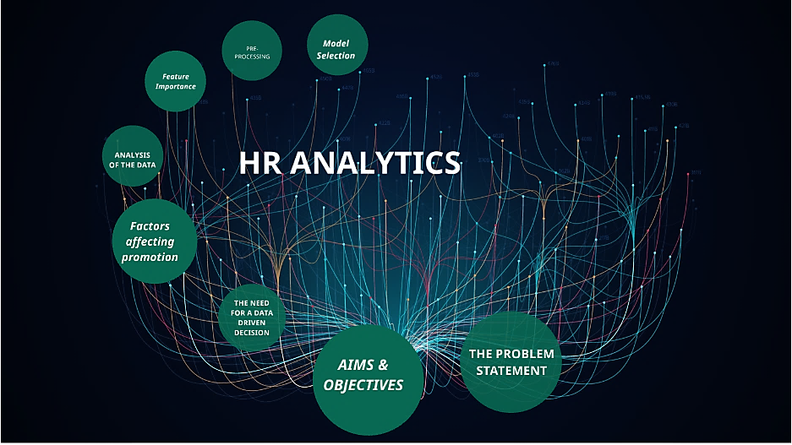
HR Analytics Data Analyst P-186
Mentor : Shruti Nigam
Group No. : 2
Group Members :
Anand Shamrao Bhoir
Naveen
Suhas
Mohammed Arfath
Nilesh

Slide 2
Project Objectives
Enhancing Data Analysis and Decision-Making through Streamlined Data Processing and Interactive
Dashboards Overview:
The primary objective of this project is to leverage the combined power of MS Excel, MySQL, Tableau, and Power BI to enhance data analysis capabilities, improve data quality through cleaning and duplicate removal, and create interactive dashboards for efficient and data-driven decision-making. The project aims to streamline the data processing pipeline and deliver insightful visualizations to facilitate informed business decisions.

Slide 3
Contents
KPI-1 : Average Attrition rate for all Departments.
KPI-2 : Average Hourly rate of Male Research Scientist.
KPI-3 : Attrition rate Vs Monthly income stats.
KPI-4 : Average working years for each Department.
KPI-5 : Job Role Vs Work life balance.
KPI-6 : Attrition rate Vs Year since last promotion relation.

Slide 4
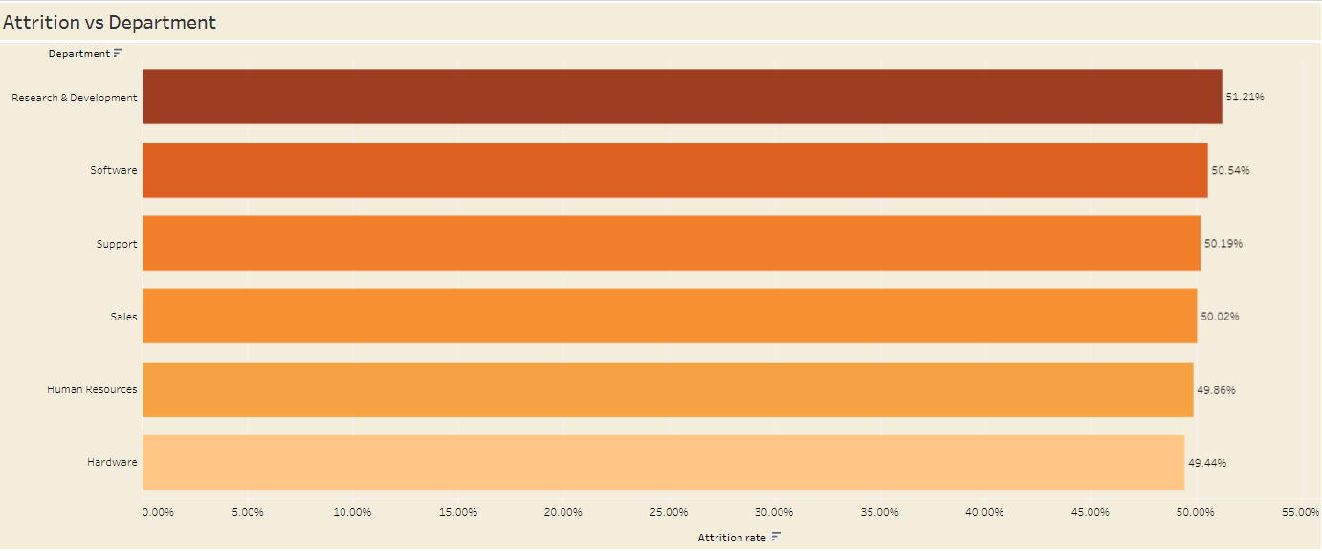
KPI-1
Attrition rate vs Department
After closely monitoring the chat data, it is evident that the attrition rates vary across different departments within the organization. Among all the departments, the Research and Development (R&D) department has recorded the highest attrition rate, standing at 51.21%. Following closely behind, the Software department has also experienced a significant attrition rate of 50.54%. On the other hand, the Hardware department has the lowest attrition rate among all departments, with a rate of 49.44%.

Slide 5
KPI-2
Average Hourly rate of Male Research Scientist
According to the available data, it has been found that male research scientists earn an average hourly rate of 114.45.

Slide 6
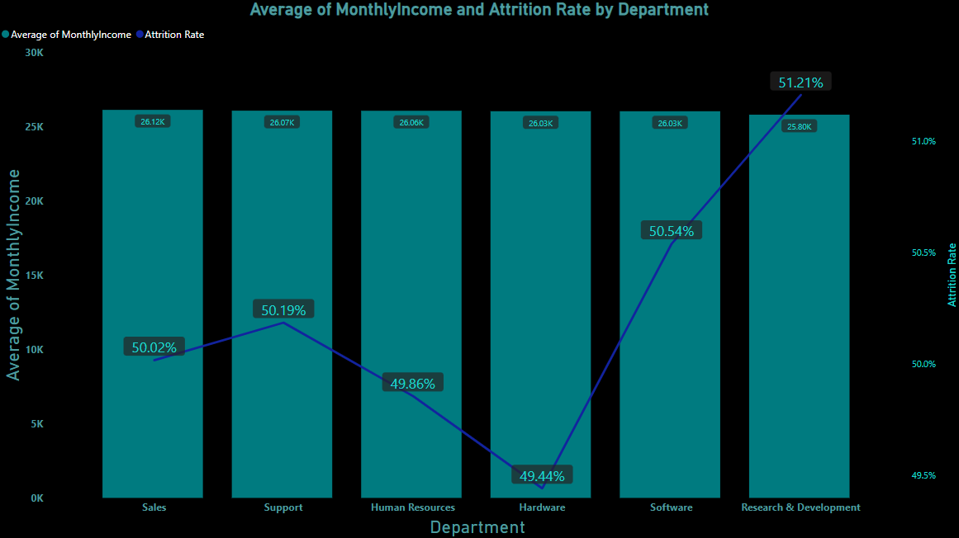
KPI-3
Average of Monthly Income and Attrition Rate By each Department
According to the analysis of the bar and line chart, it is evident that the Research and Development department receives a comparatively lower average monthly income of 25.80K. Additionally, this department experiences a significantly higher attrition rate of 51.21%. Following closely behind is the Software department, with an average monthly income of 26.03K and an attrition rate of 50.54%.

Slide 7
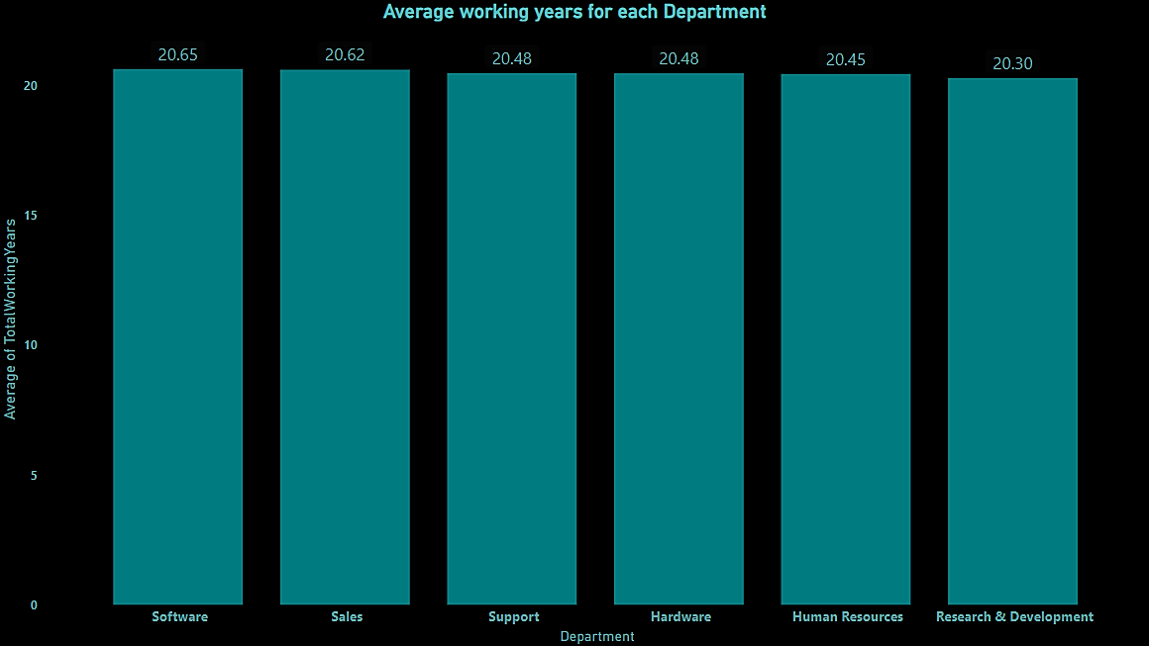
KPI-4
Average Working Year for Each Department
Based on the data depicted in the chart, it is evident that the software department exhibits the highest average total working years among all departments, standing at an impressive 20.65 years. Conversely, the research and development department demonstrates the lowest average working years at 20.30 years. These findings emphasize the substantial experience and longevity of the software department's workforce, while highlighting the relatively lower tenure within the research and development department. Such insights provide valuable information for assessing the departmental dynamics and potential areas of focus within the organization.

Slide 8
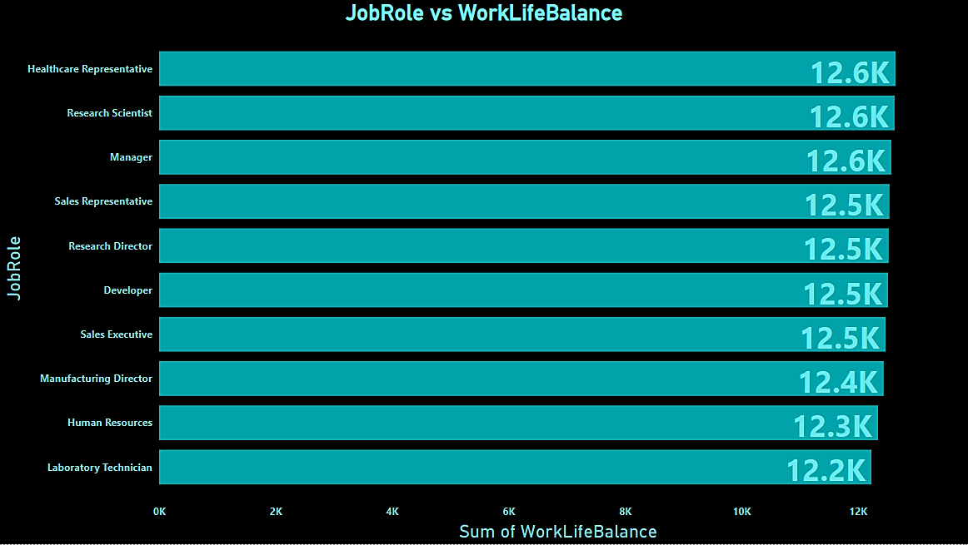
KPI-5
Job Role Vs Work Life Balance
A comprehensive analysis of work-life balance among different job roles reveals intriguing findings. Among the various professions studied, healthcare representatives seem to be grappling with a considerably poor work-life balance, with a staggering gap of 12.6k compared to other roles. In stark contrast, laboratory technicians emerge as the winners in this aspect, enjoying a superior work-life balance when compared to their peers. These results shed light on the importance of fostering healthier work-life integration and highlight the potential benefits of emulating practices from the laboratory technician role to enhance overall well-being across professions.

Slide 9
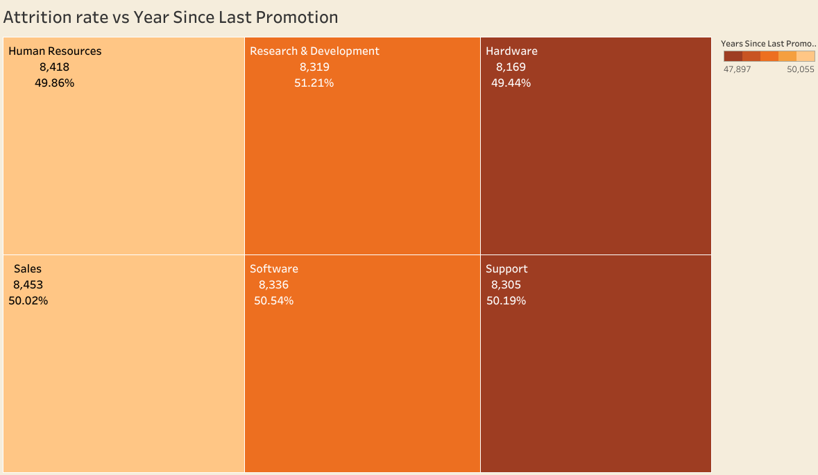
KPI-6
Attrition rate vs Year Since Last Promotion
According to the data analysis, the Hardware department has achieved a remarkable success in managing employee attrition with an impressively low rate of 49.44% following the last promotion. This result suggests that the promotion policy implemented in the Hardware department has proven to be highly effective in retaining employees and fostering a positive work environment.
However, the Software department has faced challenges with the highest attrition rate of 50.54% after the last promotion. This indicates that the promotion policy in the Support department may need further examination and improvement to address the underlying factors contributing to employee turnover.

Slide 10

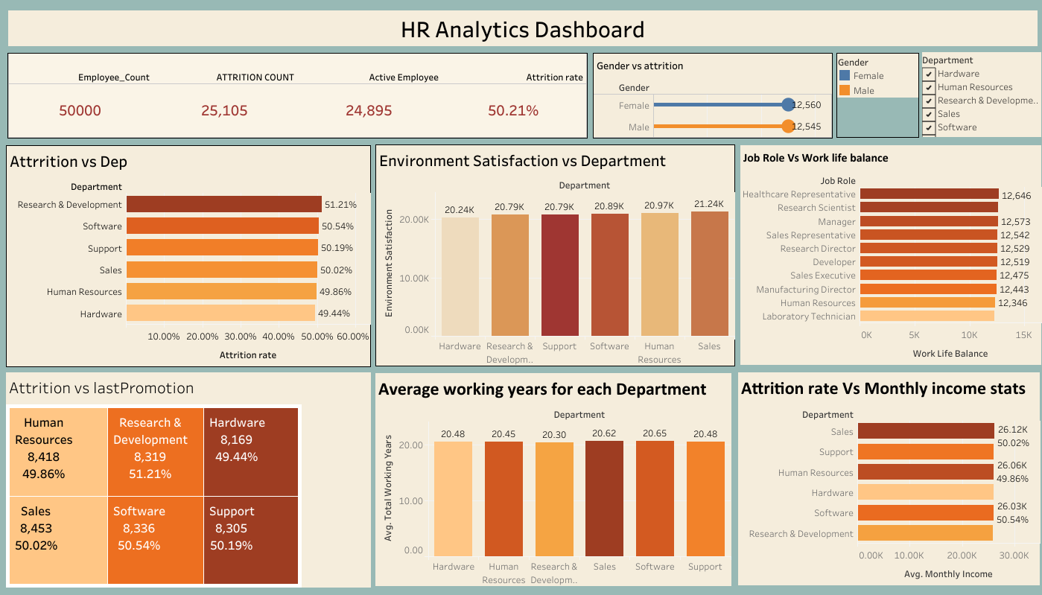
Tableau Dashboard

Slide 11
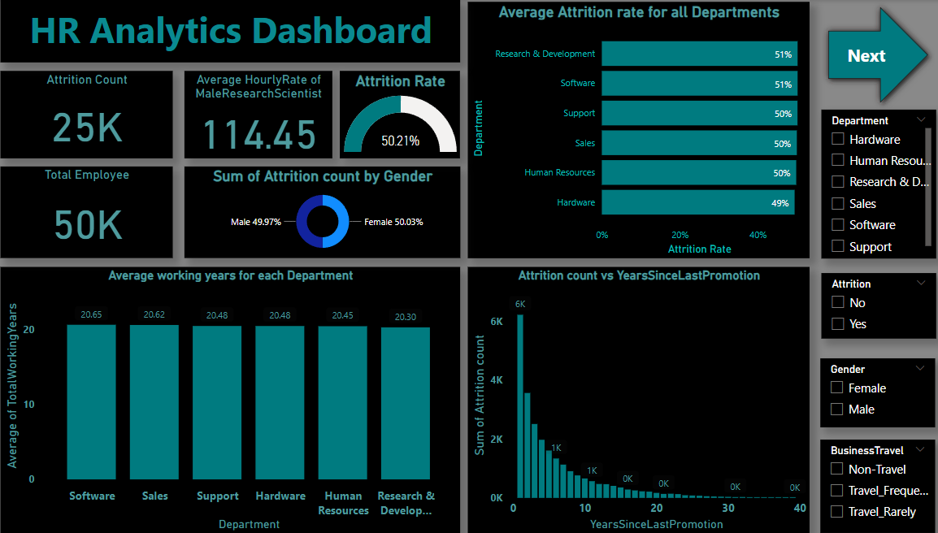

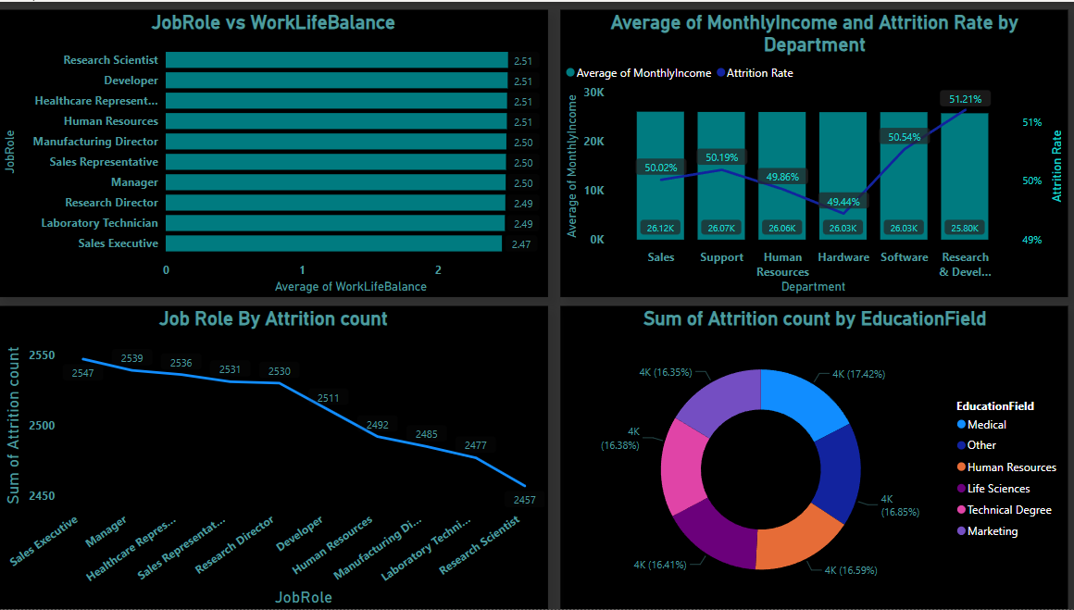
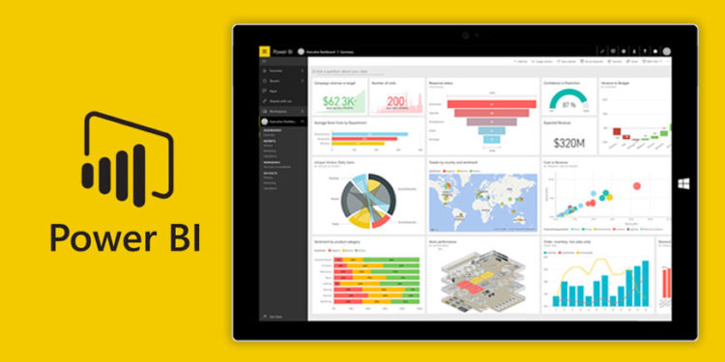
Power BI Dashboard

Slide 12

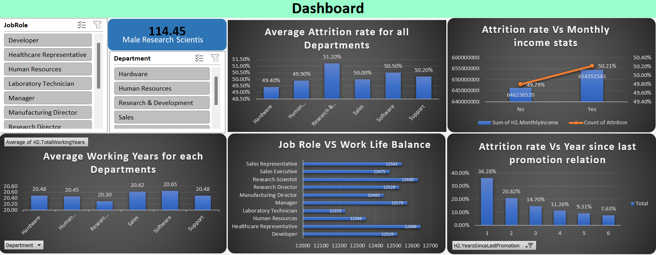
Excel Dashboard

Slide 13

MySQL
-- Avg Attrition by All Department
select department, count(case when attrition = "yes" then 1 end) as AttritionCount,Count(*) as TotalEmployees,count(case when attrition = "yes" then 1 end)/count(*) * 100 as attritionratefrom hr1 a inner join hr2 b on a.EmployeeNumber=b.employee_id group by Department;
-- Average of Totalworkingyear by each department
select department,avg(totalworkingyears) as TotalWorkingYears from hr1 a inner join hr2 b on a.employeenumber=b.employee_idgroup by department;
-- Attrition count vs YearsSinceLastPromotion
select sum(case when Attrition="Yes" then 1 end) as attrition ,count(YearsSinceLastPromotion) from hr1 a inner join hr2 b on a.EmployeeNumber=b.employee_id group by YearsSinceLastPromotionorder by YearsSinceLastPromotion desc;
-- Attrition by job level
select JobLevel,count(case when attrition="yes" then 1 end) as Attritioncount,count(*) as TotalEmployees,count(case when attrition = "yes" then 1 end) / count(*) *100 as Attritionratefrom hr1 ainner join hr2 b on a.EmployeeNumber=b.Employee_ID group by JobLevel order by attritionrate desc;
-- JobRole Vs WorklifeBalance
select Jobrole, sum(worklifebalance) as WorkLifeBalancefrom hr1 a inner join hr2 b on a.EmployeeNumber=b.Employee_ID group by jobrole;

Slide 14
Recommendations
Competitive Compensation: The data indicates that the average monthly income for employees in the R&D and Software departments is relatively lower compared to other departments. To address this, the company should conduct a thorough salary analysis to ensure that the compensation offered to employees in these departments is competitive and aligns with industry standards.
Career Growth Opportunities: High-performing employees are more likely to stay if they see clear career growth opportunities within the organization. Implement a well-defined career progression plan that provides employees in R&D and Software departments with a clear path for advancement and development.
Employee Recognition and Rewards: Recognizing and rewarding employees' efforts and achievements can significantly improve their job satisfaction and motivation. Consider implementing an employee recognition program in these departments to acknowledge and celebrate employees' contributions.
Work-Life Balance: The data suggests that work-life balance might be a concern, especially for healthcare representatives. Offer flexible working arrangements and promote a healthy work-life balance across all departments, including R&D and Software.
Retention Bonuses and Incentives: To encourage employees to stay with the company, consider offering retention bonuses or other incentives tied to their length of service. This can be particularly effective for employees with specialized skills in R&D and Software.

Slide 15
Exit Interviews and Feedback: Conduct exit interviews with employees who leave the organization to understand their reasons for departure. Use this feedback to identify trends and address any underlying issues in R&D and Software departments that may be contributing to attrition.
Employee Engagement Initiatives: Engaged employees are more likely to stay committed to their roles. Implement regular engagement surveys and focus groups to assess employee satisfaction and identify areas for improvement in R&D and Software departments.
Training and Development: Invest in continuous training and development programs to enhance employees' skills and knowledge. This can increase their sense of value within the organization and improve their job satisfaction.
Supportive Management: Ensure that managers in R&D and Software departments are trained to be supportive, understanding, and empathetic leaders. A positive relationship with management can significantly impact employee retention.
Diverse and Inclusive Culture: Foster a diverse and inclusive work environment where employees feel valued and respected, regardless of their background. An inclusive culture can help reduce turnover and improve overall employee satisfaction.
Remember, each department may have its unique challenges, so tailor these recommendations based on specific insights from each department's feedback and performance data. Regularly monitor the impact of these initiatives and make adjustments as needed to improve employee retention across the organization.

Slide 16
Summary of Recommendations to Improve Employee Retention: 1. Conduct a salary analysis to ensure competitive compensation in R&D and Software departments. 2. Establish a clear career progression plan to offer growth opportunities. 3. Implement an employee recognition program to boost job satisfaction. 4. Offer flexible working arrangements to address work-life balance concerns. 5. Consider providing retention bonuses or incentives, particularly for specialized skills. 6. Conduct exit interviews and use feedback to make necessary improvements. 7. Implement engagement surveys and focus groups to assess employee satisfaction. 8. Invest in continuous training and development programs to enhance skills. 9. Provide training for managers to be supportive and empathetic leaders. 10. Foster a diverse and inclusive work environment to promote employee satisfaction. By adopting these measures and adapting them based on department-specific insights, the company can enhance overall employee retention and create a positive work culture. Regular monitoring and adjustments will be crucial for long-term success in retaining valuable talent in R&D and Software departments.

Slide 17
Thanks !

